Slide 1
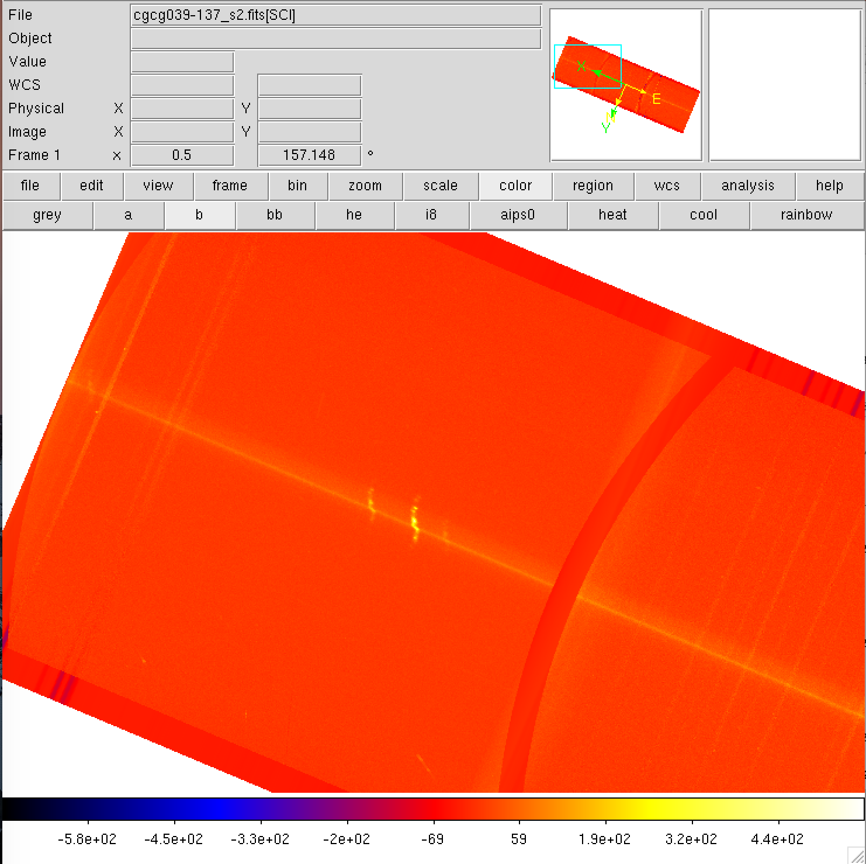
Red side
Blue side
Increasing wavelength
Notes:
Corrected (11/2017)

Slide 2
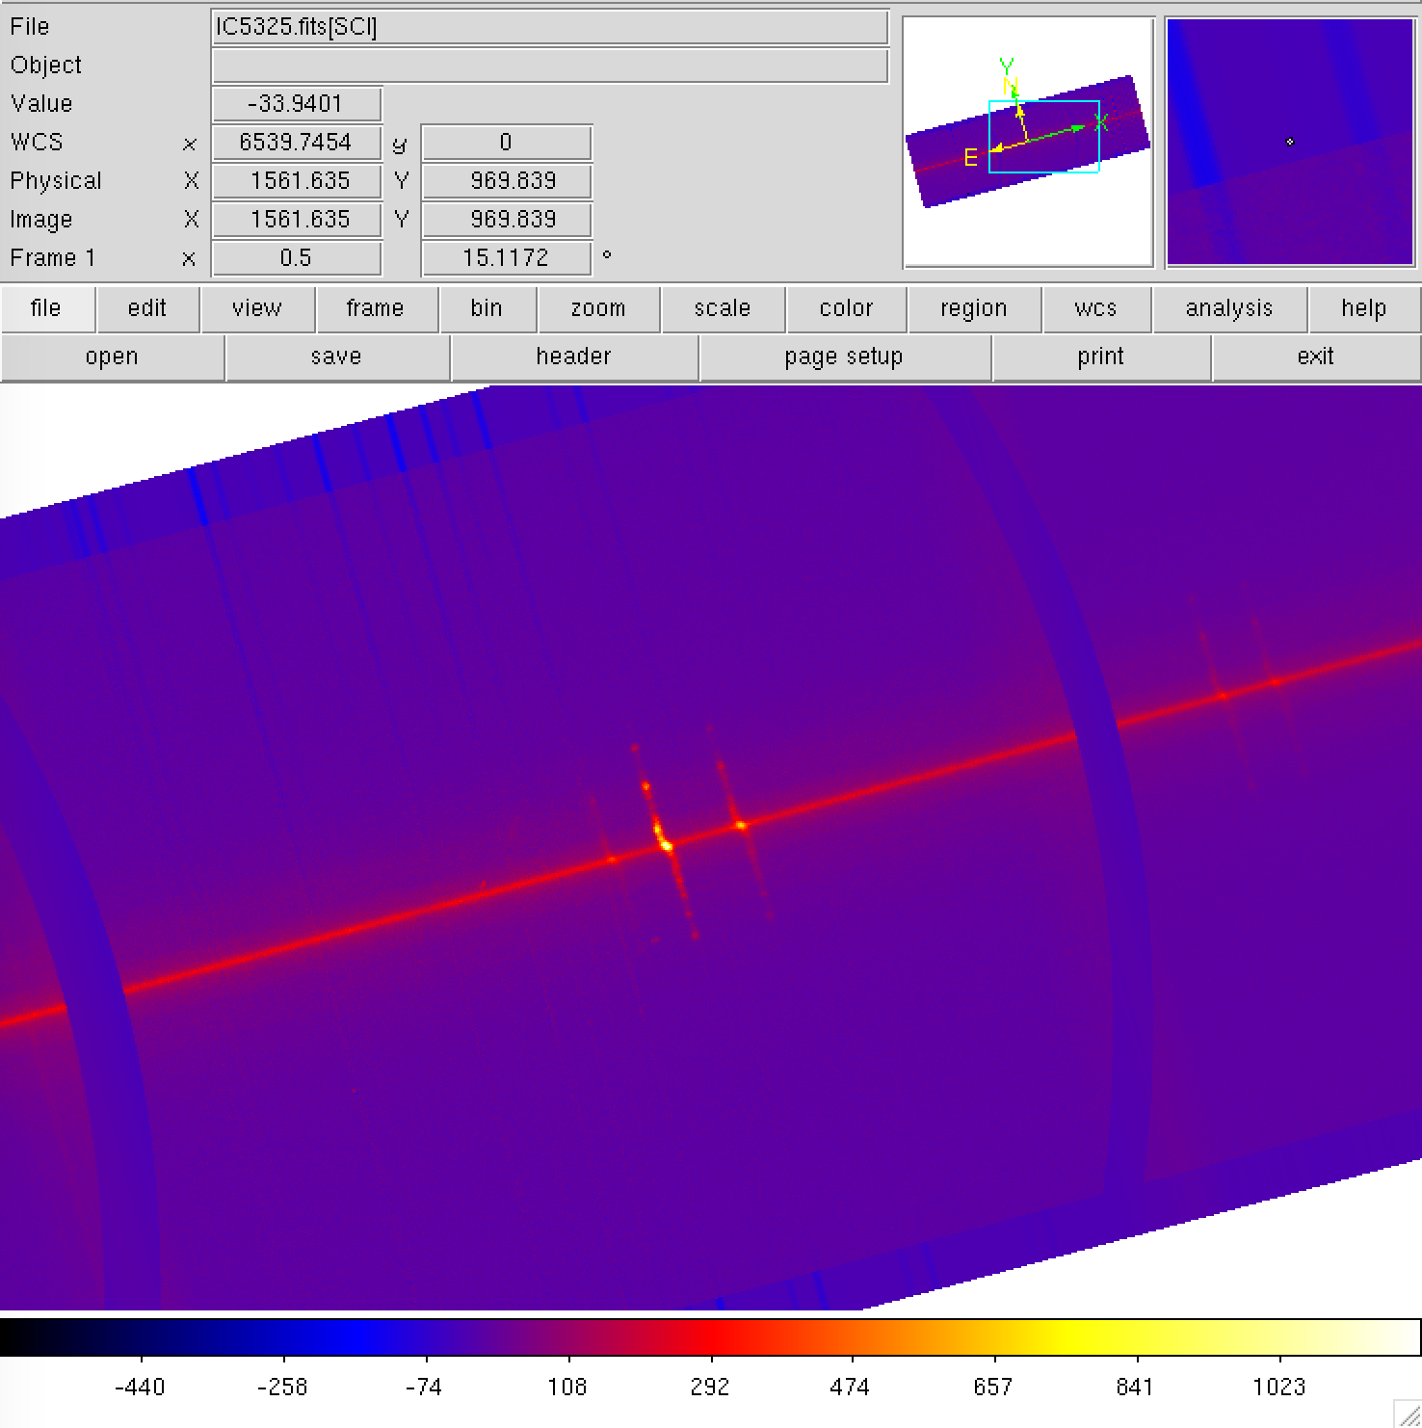
15 deg rotated
Blue side
Red side
Increasing wavelength
Notes:
Correct (11/20/17)

Slide 3
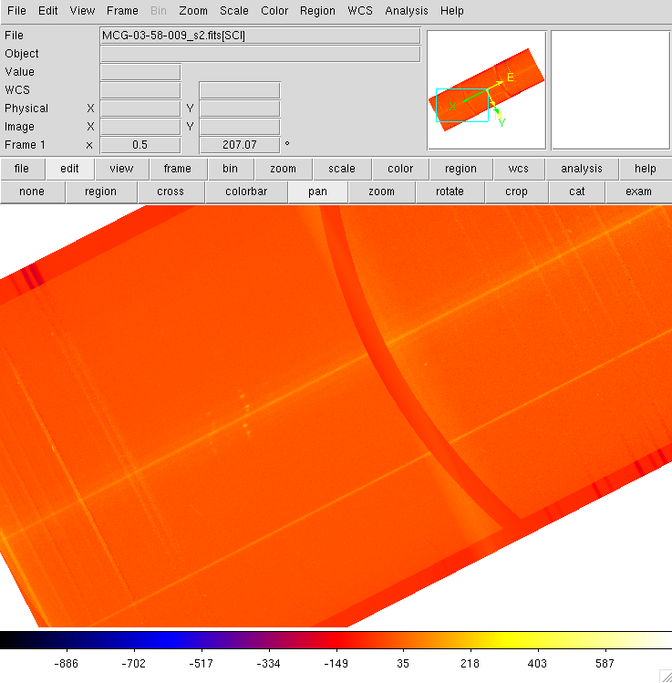
blue
red
Increasing wavelength
Notes:
Correct (11/20/17)

Slide 4
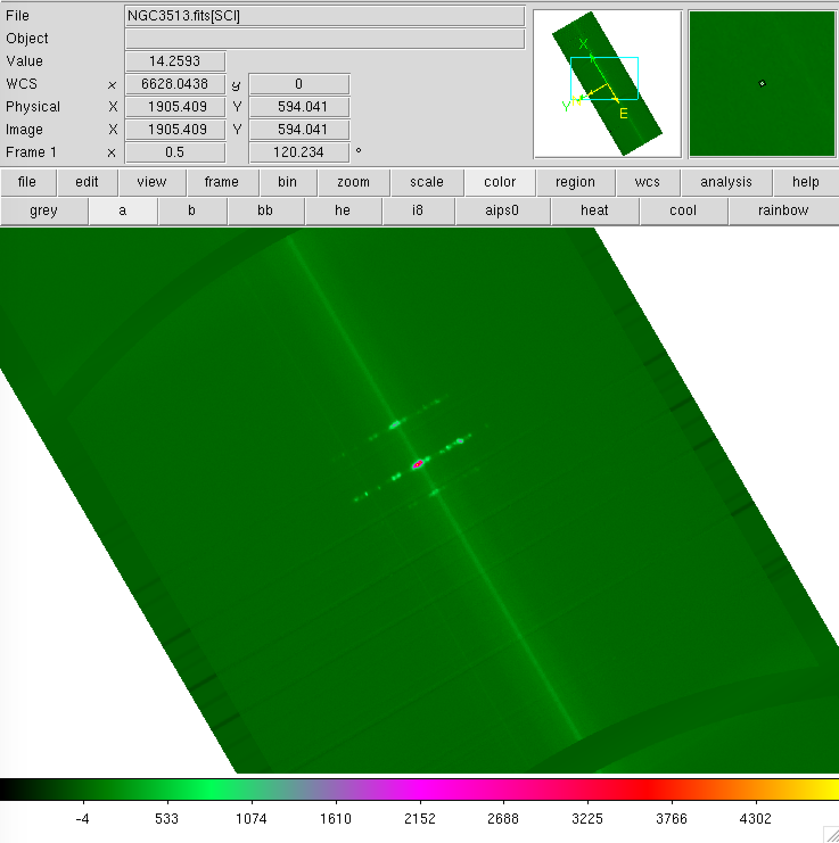
Increasing wavelength
Blue side
Red side
Notes:
Correct (11/20/17)

Slide 5
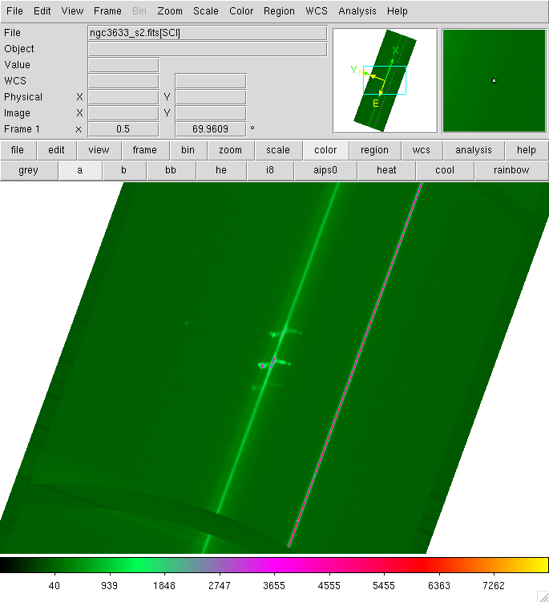
Increasing wavelength
Red side
Blue side
Notes:
This should be correct (11/20/17)

Slide 6
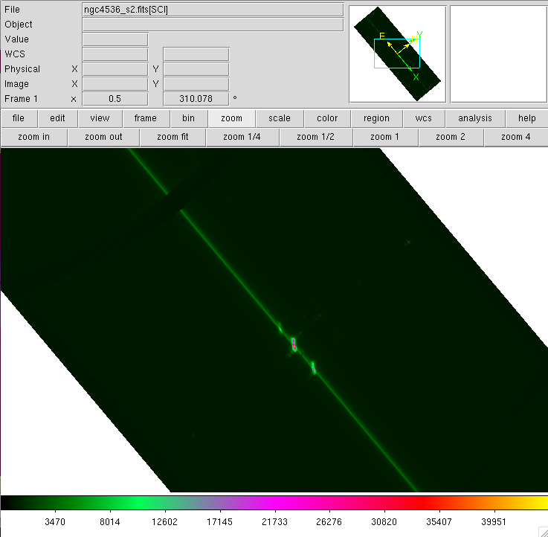
Increasing wavelength
Blue side
Red side

Slide 7
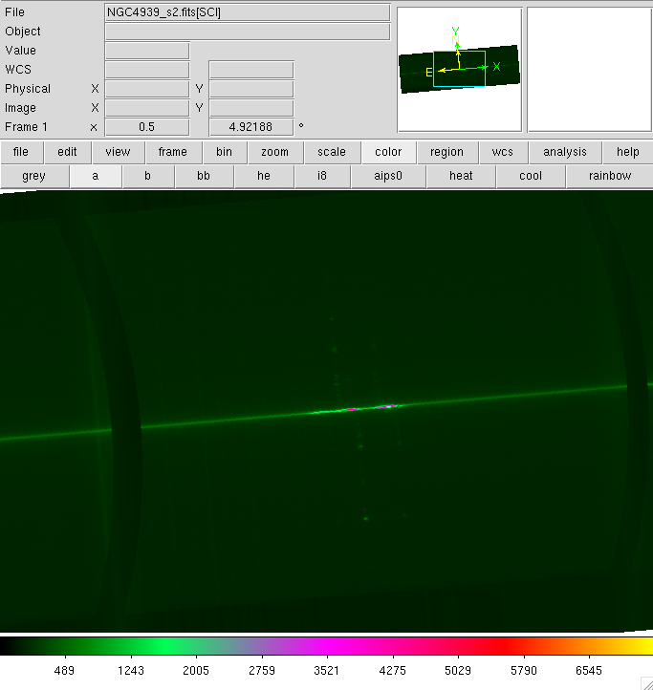
blue
red
Increasing wavelength

Slide 8
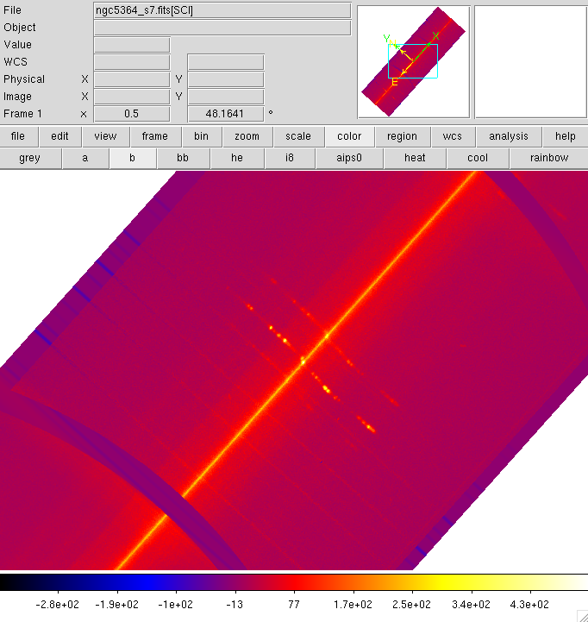
Red side
Blue side
Increasing wavelength

Slide 9
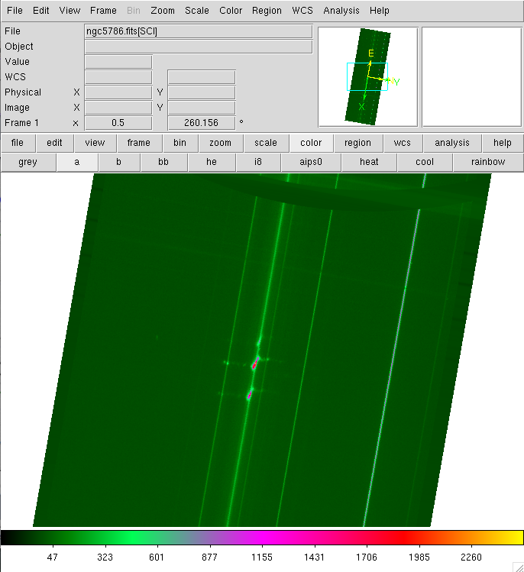
Blue side
Red side
Increasing wavelength
Notes:
This should be correct (11/20/17)

